Slide 1
USER Manual

Slide 2
User Manual
Samsung
Refrigerator
Keep cool
Highlights
Perfect and prompt service
Quality is the motto
Efficiency is evident
S

Slide 3
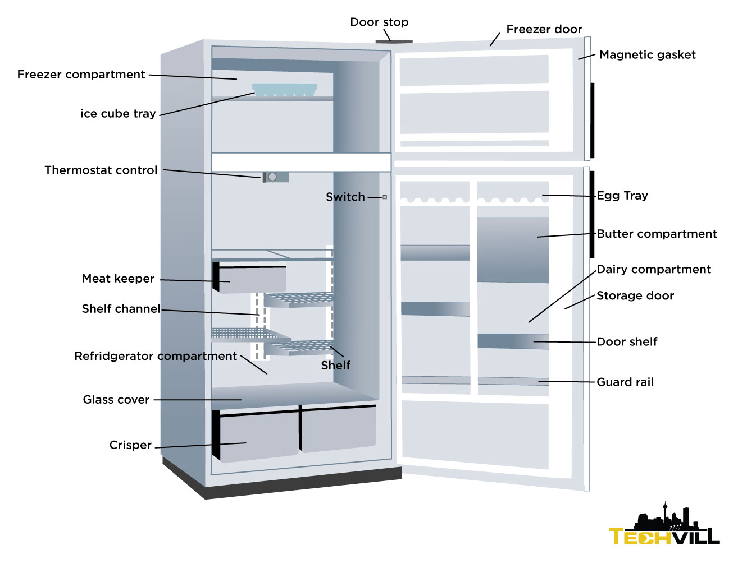
Picture

Slide 4
Precautions during Installation
Do’s
• Install this refrigerator on a firm, flat surface.
• For optimum operation, normal room temperature is recommended.
Allow a 50mm space between the refrigerator and the wall.
• For personal safety, properly earth this appliance
Don’ts
Avoid locations affected by draughts or dampness.
•Avoid plugging in multiple switch provision

Slide 5
Precautions while using
• Do’s
Place any water connection away from the refrigerator.
Do remove ice cubes after defrosting the refrigerator
Donts
• Do not allow unattended children to play in or around refrigerators and other appliance.
. • Do not use flammable sprays such as liquor and paint near the refrigerator. Heat from the refrigeration unit may ignite flammable aerosols.
• Do not store volatile chemicals such as ether and benzene in the refrigerator. The fumes, besides damaging food, can build up and cause an explosion.

Slide 6
Trouble Shoot
Stops getting chillness
Vacuum created due to the coils under or behind the fridge.
Clogged coils can cause poor cooling. Check to make sure nothing is stuck in the condenser fan and that it spins freely (models with coils on the back won't have a fan). To do this, unplug the fridge and pull clogged coils out and assemble it properly

Slide 7
Guarantee and Warranty
6 months warranty
3 years guarantee

Slide 8
Contact address
Show room
Shyam Electronics
13 Valliammal Street
Thanjavur 613007 04362 -235660
Service station
Shyam Samsung Service Centers
43 Kannan street
Thanjavur 613007 04362-235666

